Slide 1
Fair Housing Discrimination: Early Insights
Sponsor: Jesse Purvis, Councilor Louijeune
Team Members: Adriana Alvarado, Tianyi Bao, Rafael Perron, David Sullo, Song Xu

Slide 2
Our Motivation and Goals
Motivation:
Our insight throughout the semester will reflect whether or not lenders truly follow a fair process for all loan applicants, and will hopefully be used to encourage changes in the current lending process.
Goals:
The project focuses on individuals seeking neighborhood home ownership. The goal is to compare data for people participating in first time home ownership programs and data for people buying homes using loans to find if there is discrimination in the banking/lending process.

Slide 3
Background Required for Project
We believe having at least some knowledge in following areas will help in understanding the project:
First Time Home Buyer Programs (FTHB) in Massachusetts
HDMA Data Value and Definitions

Slide 4
What We Have Done
Attend meetings
Weekly with PM
Weekly with team members working on the project
Analyze the dataset
Determine how many loans were taken by county
Establish who is participating in first time home ownership programs
Distribution of different races, age, gender and their incomes
Average Income by applicants who got accepted and denied
Percentage of loans that were rejected out of total loans for each race and sex

Slide 5
What We Have Done
Analyze the dataset
Determine how many loans were taken by county
Establish who is participating in first time home ownership programs
Distribution of different races, age, gender and their incomes
Average Income by applicants who got accepted and denied
Percentage of loans that were rejected out of total loans for each race and sex

Slide 6
How We Divide Our Works
Rafael Perron
Team Leader
Divide the tasks by variables to each team member
Organize issues created by team members and communicate with the PM
Adriana Alvarado, Tianyi Bao, David Sullo, Song Xu
Visually and statistically exploring and summarizing the main characteristics and patterns of the subset of the dataset we got assigned from the team leader

Slide 7
Data We Have Used
HMDA Dataset: msamd_14454.csv
Additional data planned to use for our extension research:
Boston Redlining Data
Boston Neighborhood Composition Data

Slide 8
Early Insights From the Data - Question 1
The most loans are taken out in Norfolk County, followed by Plymouth, and Suffolk.

Slide 9
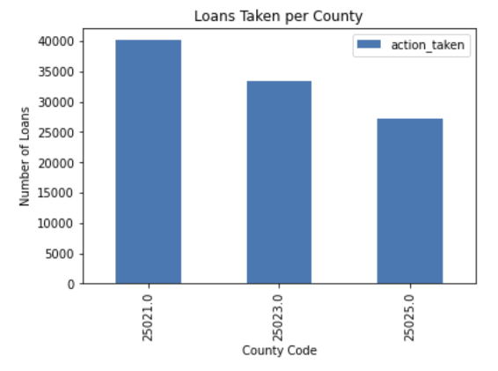
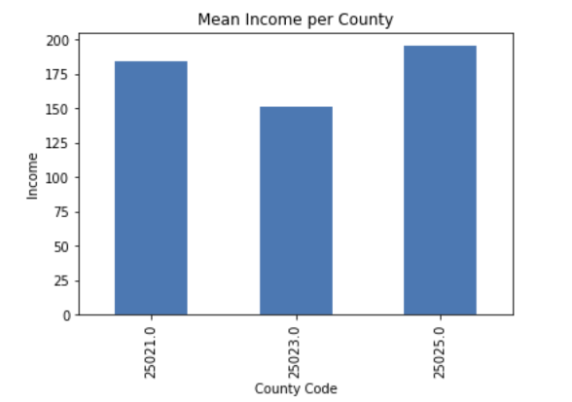
25021 = Norfolk
25023 = Plymouth
25025 = Suffolk
Interesting to note that income isn’t correlated to number of loans taken.

Slide 10
Early Insights From the Data - Question 2
White and Asian people have a higher average income than black and pacific islanders people. White people make up the higher percentage of people in the dataset by far. More black people than Asian people.
Native Hawaiian and Pacific Islander people have the highest rate of loan rejection, followed by American Indian/ Alaska native, black, asian, and finally white.
Single Family: Manufactured loans are generally applied by lower income applicants, followed by Single Family: Site-Built, then finally Multifamily: Site-Built
Type 2 (Federal Housing) and Type 1 (Conventional) loans are the most likely to be rejected.

Slide 11
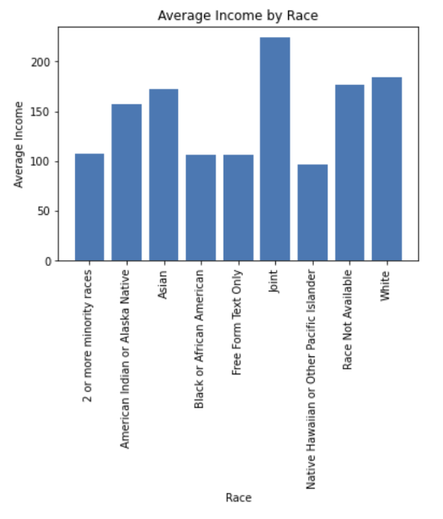
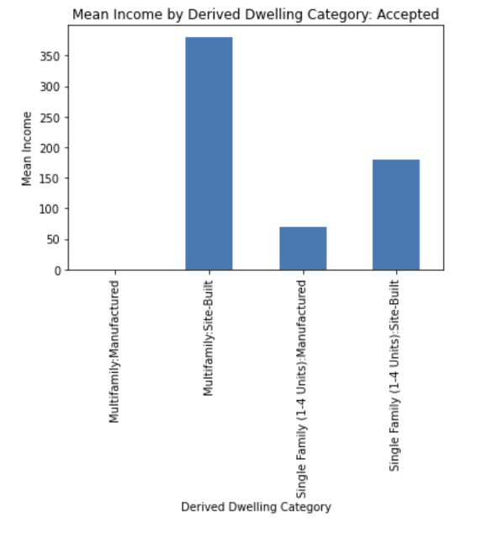
Figure
1
Figure
2
In figure 1, we can ignore “joint” and “race not available”
We see that white, asian, and american indian are the three highest average incomes, while black, pacific islander, and mixed are the three lowest.
In figure 2, we see that those who apply for single family homes have a much lower income on average than multifamily

Slide 12
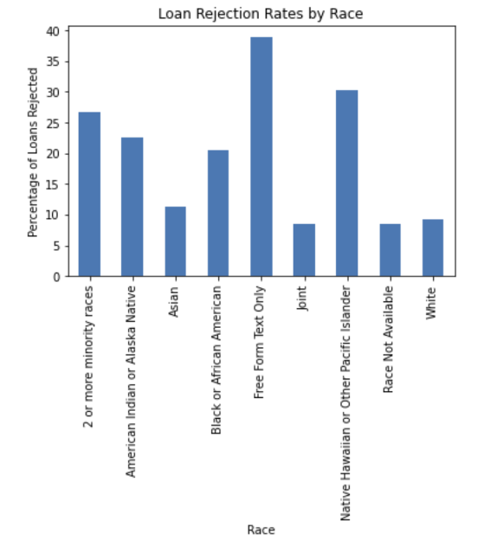
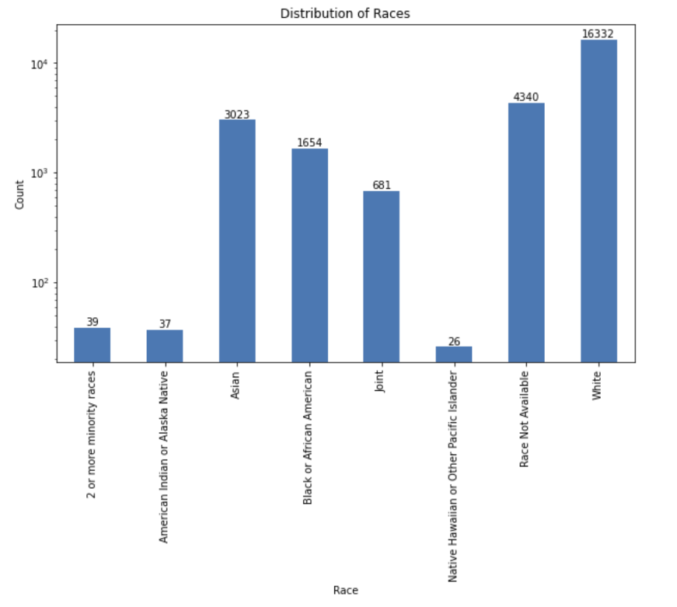
Figure
3
Figure
4
It is very interesting to note that rejection rates don’t directly correlate with average income. For example, american indians have a relatively high rejection rate, but their average income was pretty high.
And those whose race is other (“free form text”) have the highest rejection rate
Note that the population of native, american indian, and mixed is super low compared to the other races

Slide 13
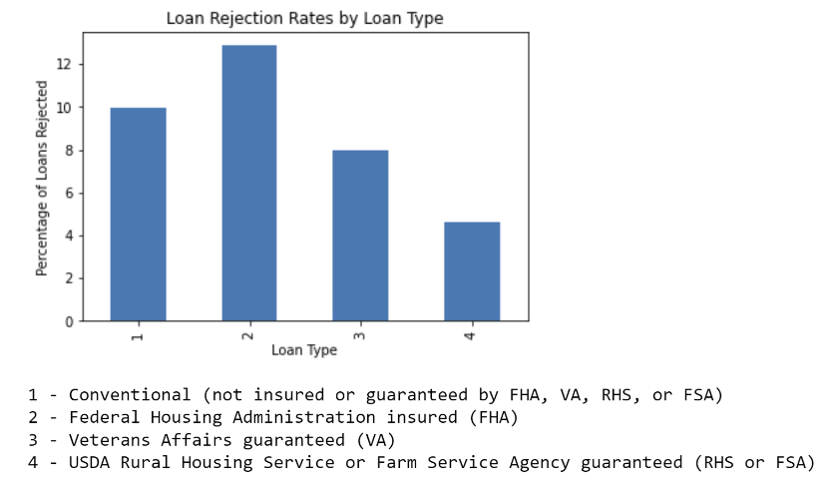
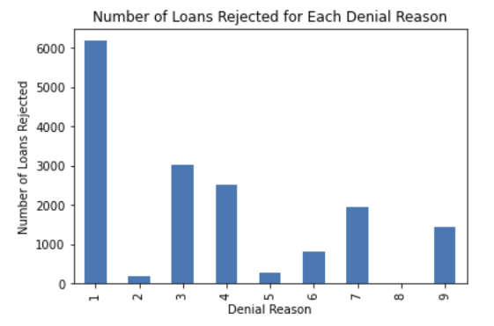
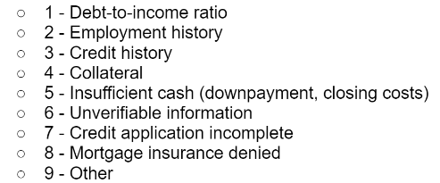
The vast majority of loans are rejected due to “debt to income ratio”, second most is credit history. Most loans that are rejected are Federal Housing Loans

Slide 14
Early Conclusions / Difficulties
There initially seems to be a trend of discrimination, but ideally we’d like to adjust for changed variables before drawing conclusions.
For example, do people of color face a higher rate of loan rejection because they are of color, or because they on average have a lower income? Is the rejection rate higher than it should be once we adjust for these variables?
This is the next step.

Slide 15
Additional Challenges & Next Steps
Find any other datasets online that might help us further identify any discrimination with the loan approvals
Expand our data to look at other factors beyond just loan rejection and income
The dataset is expansive and we need to determine which columns are useful
Question: How will we move forward with these analyses to determine who is likely to participate in the First Time Home Ownership Program?

Slide 16
Extension Proposal
We would like to determine which neighborhoods have historically been discriminated against via practices such as redlining to check for any correlations between the ethnic makeup of these areas. We will utilize two data sets to help expand our research: Boston Redlining Data and Boston Neighborhood Composition Data. To visualize this issue, we would be plotting the ethnic composition of neighborhoods deemed as “Hazardous” and “Best” to look for any disparities. By examining these two datasets, we will hopefully be able to answer the following questions regarding discrimination in lending for first time home owners:
How do the ethnic compositions of “Hazardous” neighborhoods compare to “Best” neighborhoods? Are there noticeable differences?
Are any of these neighborhoods grouped together, indicating a larger trend in discrimination?
Are the ethnic groups prominent in “Hazardous” neighborhoods the same ones seeing fewer loan approvals in the HDMA dataset?

